Slide 1
FCM and its role in advocating for municipal interests on the federal stage
Presentation to the Association of Manitoba Municipalities
AMM Spring Convention 2025

Slide 2

About FCM
A national voice for local governments
FCM represents over 2100+ municipalities across Canada
Membership spans 92% of the Canadian population
Includes 18 different provincial/territorial municipal associations
FCM advocates to advance municipal priorities vis a vis the federal government, including during federal elections, federal budgets, ongoing proactive advocacy, and on legislative and regulatory matters

Slide 3
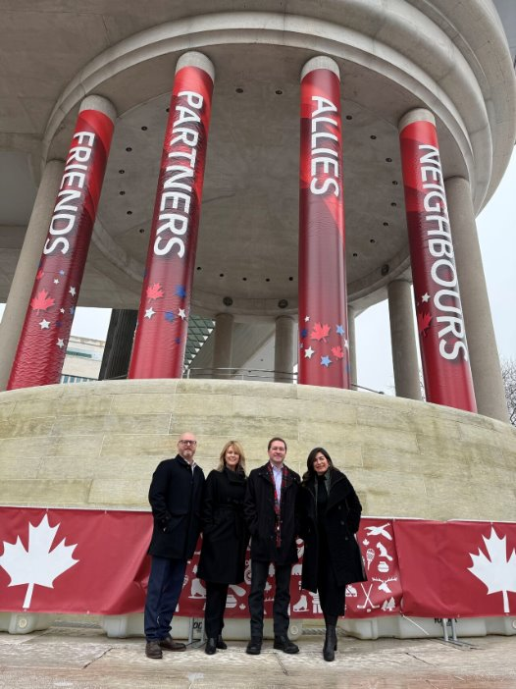
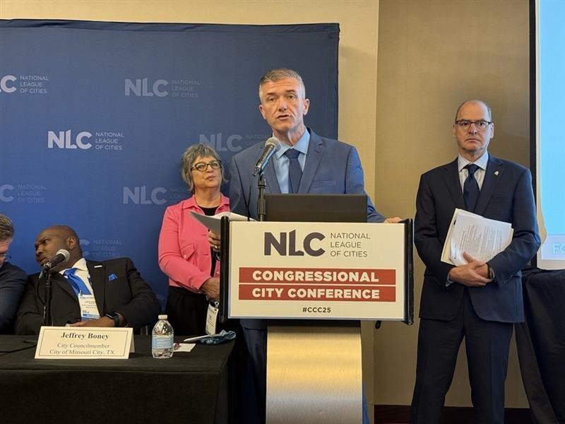
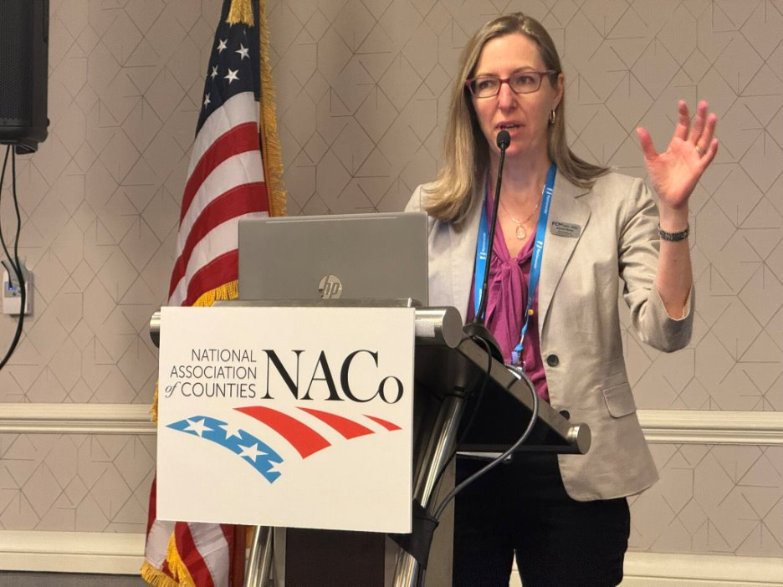
Context
2025 Federal Election is characterized by high political and geopolitical volatility
Cost of living crisis, lagging productivity
Trade war with the United States as backdrop
Local diplomacy efforts in the United States as part of Team Canada
Cross-cutting advocacy domestically to safeguard municipal interests
Need to partner across all orders of government to navigate the uncertainty
Increased focus on the need to build a stronger, more resilient Canada
Election is April 28th

Slide 4

Narrative: Stronger Together — Local Strength, National Prosperity
Building a prosperous and resilient Canada starts in our local communities. It’s time for a modernized National Prosperity Partnership to improve economic resilience and quality of life for all Canadians.

Slide 5
Our strategic objectives
Promoting local communities as Canada’s engines of prosperity
Positioning municipalities as trusted and responsible frontline government partners focused on Canadians’ priorities
Empowering and engaging our members
Building government, public and stakeholder awareness and support for key municipal priorities

Slide 6



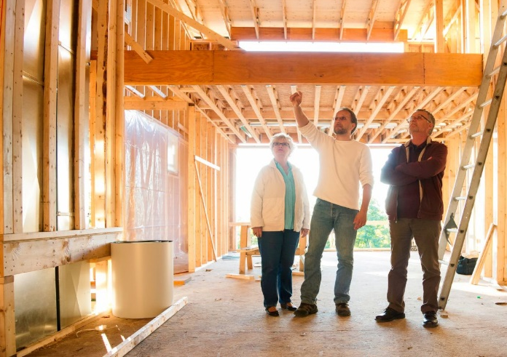
A true National Prosperity Partnership will ensure that municipalities—who create the conditions for economic growth—can reinvest in building a stronger, more resilient Canada.
Long-term investment certainty
Prioritizing local needs
A direct link between municipal investment, economic growth and resilience

Slide 7

Our advocacy priorities
A true National Prosperity Partnership will move Canada forward by ensuring all orders of government work together to:
Support local economic growth and resilience so communities can attract businesses and ensure good jobs for Canadians.
Invest in infrastructure renewal to drive productivity and competitiveness.
Achieve housing affordability so Canadians (especially young Canadians) can look to their future with confidence.
End homelessness with solutions that work at the local level.
Keep communities safe and support vital emergency services.
Reduce economic disruption by investing in climate-resilient infrastructure.
Support thriving rural, northern and remote communities.

Slide 8
Local economic growth and resilience
Municipalities are ready to partner for prosperity with the federal government and the provinces and territories to safeguard our local economies.
FCM’s recommendations to federal parties:
Invest in local strength by advancing a modernized municipal fiscal framework, including:
Increasing direct annual transfers to municipalities
Working with provincial and territorial governments on a comprehensive municipal finance reform package
Reduce interprovincial trade barriers
Reduce CFTA exemptions
Improve labour mobility
Advance building code harmonization
Invest in trade and business-enabling infrastructure
Roads, highways, bridges, rail, airports, deep-sea ports
Municipal infrastructure that keeps our communities running
Broadband infrastructure
Streamline federal permits and approvals, while continuing to protect our environment and advance Indigenous Reconciliation
Establish national utility corridors

Slide 9
Infrastructure development and renewal
Further to advocating for a true National Prosperity Partnership to advance a modernized municipal fiscal framework, FCM’s recommendations to federal parties on infrastructure include:
Invest in housing-enabling infrastructure
Establish a new dedicated $3B over three years federal water and wastewater infrastructure fund
Invest $500M annually for 10 years in core rural and northern infrastructure
Accelerate progress towards universal internet access and cellular coverage
Provide long-term public transit capital funding starting in 2025 at $3B per year, indexed annually
Immediately increase investments in disaster mitigation and adaptation by $2B, with an additional $1B earmarked each year for the next decade

Slide 10
A thriving and safe Rural, Northern, Remote Canada
Local economic growth & resilience and infrastructure development & renewal, including to advance universal internet access and cellular coverage, are essential for strong local communities in Manitoba.
Additional FCM recommendations to federal parties:
End rural homelessness and fix the rural housing crunch
Strengthen Canada’s bail system to address repeat offending
Strengthen efforts to ensure optimal RCMP staffing and service levels
Commit to meaningful consultation with municipalities on the future of RCMP contract policing

Slide 11
Our advocacy tactics:
Promoting Local Communities
Traditional and social media engagement
Tracking Leaders' tours & strategic and "battleground" ridings
Trusted Government Partners
Leveraging diplomacy efforts on Canada-US to champion local leaders
Empowering Members
Building Support for Priorities
Leveraging backchannel contacts within campaigns
Focus on partnership in materials and engagement efforts
Action Centre resources on Strongertogether.fcm.ca
Platform analysis
Networking events
Targeted member mobilization
Rapid response on items of municipal interest

Slide 12
Weekly approach:
Ongoing central engagement and member mobilization in line with leaders' tours, in strategic ridings and in battleground ridings
Comms approach flexible to federal party campaign direction, rapid response on relevant campaign commitments
Op-eds, videos, news releases, and non-partisan and geo-targeted social media presence
Prep work for First 100 Days is underway
Week 1
Canada – US Relations & Tariffs
Week 2
Economic resilience focus
Week 3
Week 4
Week 5
Thriving rural communities
Public Safety
National Prosperity Partnership
Housing
Homelessness
Reconciliation
Infrastructure
Climate resilience

Slide 13
Strategic Tactics in the First 100 Days:
Annual Conference 2025
Ministerial, Public Service & MP Outreach
Budget 2025 Advocacy
Parliamentary Committee Engagement
Municipal Caucus Exploration

Slide 14

Annual Conference 2025:
Secure high-profile speakers from major parties
Key party representatives
HICC, Rural
Engage officials on municipal priorities
Leverage media opportunities

Slide 15
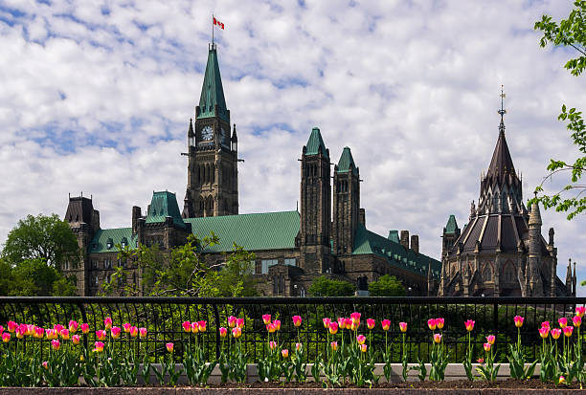
Early Ministerial Engagement:
Key targets: PMO, Finance, HICC, GAC/International Trade, PS, ECCC, ISED, Agriculture and Rural Economic Development
Build and/or re-establish relationships with Ministers. & Staff as well as Deputy Ministers and ADMs
Secure early meetings to influence direction of the new government

Slide 16

Budget 2025- Shaping Municipal Priorities:
Tabling a budget will be first order of business for new government
Critical to do immediate outreach to new Finance Minister
FCM participated in the 2025 pre-budget consultation process
Provide budget analysis to members
Prepare FCM’s response & update advocacy strategy

Slide 17
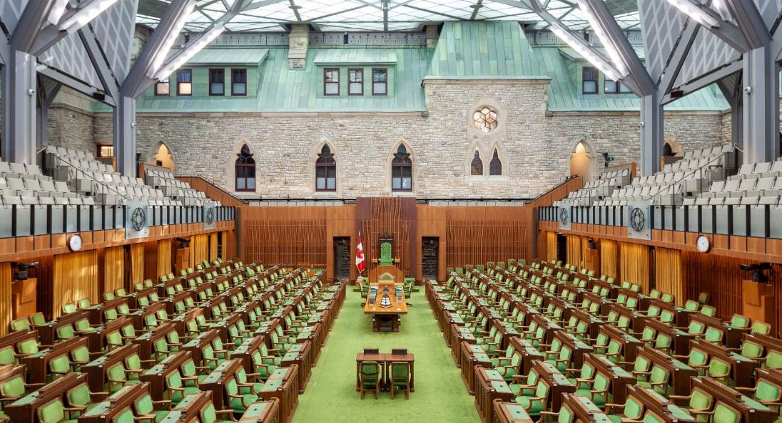
Municipal Caucus Exploration:
Goal: Identify and target MPs with municipal backgrounds to develop local champions for FCM priorities
Leverage informal 'caucus' for ongoing engagement

Slide 18
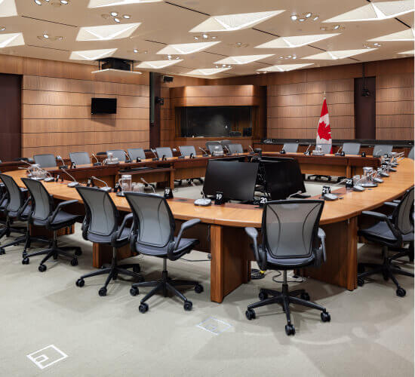
Parliamentary Committee Engagement:
Key committees: Finance, Infrastructure, HUMA and Public Safety
Identify members & staff
Secure meetings with members of committee
Position FCM as a trusted resource to the committee

Slide 19

Conclusion
The election is a critical opportunity for municipalities to shape Canada’s future.
Strategic advocacy efforts will keep municipal priorities top of mind.
Let’s get ready to drive municipal leadership in the next federal government.

Slide 20

Comments and questions are welcome!
For more information visit strongertogether.fcm.ca

Slide 21


