Slide 1
Building a Stronger Manitoba: Advancing Excellence In Municipal Administration
April 16. 2025
Notes:
Lots of challenges faced by municipalities. You’ve all seen the news, maybe even been part of it. Public trust in government seems to be at an all time low. Scrutiny is high. Difficulties finding and retaining staff. There’s been instances of unprofessional conduct, theft of municipal assets. Things are tough.
We all know that it’s costly to rehire staff, its even more costly when things go wrong. One municipality had nearly $250,000 in forensic audit and legal alone when they had to investigate unethical conduct.
There are currently no standard qualifications or requirements to be a CAO in Manitoba. We have requirements for municipal engineers, water and wastewater operators, landfill attendants, planners the list goes on. Many of the people under the responsibility of the CAO have required standard qualifications, yet the people tasked with leading them do not.
When CAOs leave, many Councils struggle with not knowing who to hire; not knowing what education or skillsets are required to succeed. Many feel they have no choice but to hire recruiters, which can be very expensive and don’t always have the best track record. Others, not having anything to go off of, hire wonderful people who do not have the skills or education needed to succeed in such demanding and dynamic roles. Often, these candidates find themselves feeling unprepared and overwhelmed and unfortunately, many end up leaving the field and their municipality for other opportunities. This costs time and money for everyone involved.
Our association took note of these challenges and knew that we had a significant role to play in providing a solution.

Slide 2
Agenda
Current Environment
Objectives
Jurisdictional Scan
Recent MMA Developments
Next Steps

Slide 3
Current Environment
34.15% of CAOS plan to leave within the next 5 years
58.54% of CAOS plan to leave within the next 10 years
Notes:
It is difficult to recruit and retain strong, professional administrators.
When hiring, many municipalities find themselves with vacancies for months or longer, even when extended notice periods are given.
When A CAO leaves, it can be disrupting to your strategic goals, service delivery and momentum.
Remaining staff often find themselves stretched even thinner, trying to cover these positions while the hiring process is underway.
MMA recently conducted a survey to better understand the current situation
From the responses received:
34.15% of CAOS plan to leave their positions within the next 5 years
58.54% will be gone within the next 10 years.
This data signals not just a looming HR issue, but a critical challenge to the stability and effectiveness of local governance

Slide 4
Current Environment
Over 63% of CAOs don’t have a succession plan
  42.6% feel that there are no interested internal candidates
  17.86% said that their internal candidates don’t feel prepared
Notes:
With so many CAOS planning to leave within the next 10 years, we wanted to take a look at succession planning. The benefits of good succession planning are extensive. It helps create a diverse talent pool, fosters employee engagement and retention and helps to ensure there is limited loss of knowledge during leadership transitions. It’s a critical concept and a key investment that should be made by our communities.
So how prepared are municipalities for their CAOs departure?
Over 63% of CAOs have no succession plan.
42.6% have no interested internal candidates
Nearly 18% said their internals don’t feel prepared
About 1/3 of CAOs don’t feel they have the time/resources to develop a plan
Nearly ½ of CAOs said that their councils haven’t prioritized succession planning
It came as no surprise to our board that succession plans haven’t been a key priority. They take time and resources to create, and municipal staff and councils are already feeling the pressure of doing more with less. We’re fighting the fires at our doorstep today and often don’t have enough time to think about what’s coming in the future. The concerning fact is that we have so many internal candidates who are not interested in leadership positions or who don’t feel prepared.
So what are we going to do about this? It is essential that we identify a way to support our net generation of leaders. We have an opportunity to take steps now to ensure that we can find qualified, professionals to become CAO when the time comes. This is something our organization took note of and have been working to address.

Slide 5
Objectives
Respond to the current decline of governance quality in local government.
Establish a system to better prepare administrators for the current and evolving local government environment.
Create an environment attractive to high potential candidates and where professionals can thrive in municipal administration (pipeline for talent).
Build the capacity of local governments to induce, support, and maintain thriving communities.
Build public confidence in the competency of local government.
Modernize our act and empower MMA as a professional association.
Notes:
In reviewing the challenges faced by municipalities, we identified several objectives that we wanted to achieve.

Slide 6
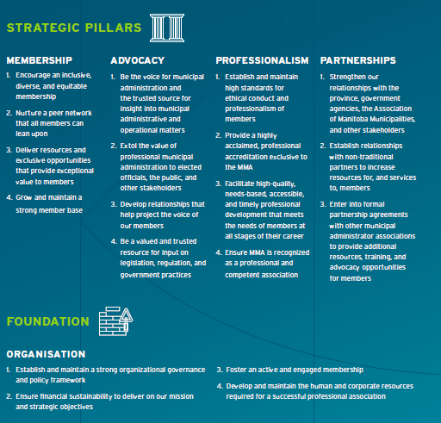

Notes:
In 2021, the MMA began the development of our new multi-year strategic plan. It was finalized in 2022.
Two of our strategic pillars are key to our discussion today, and the work the MMA has been doing over the last 2 years.
First, we want to expand our membership and connect with anyone doing municipal administration. We’ve been making strides on this and have over 300 members today.
Second, we want to generate a pipeline of talent into our sector to ensure municipalities have a pool of trained and skilled administrators to draw upon.
Third, we wanted to ensure our members understood and upheld the duty of care administrators have to the public, councils, each other, and our association. To build and reinforce the confidence in our profession as we manage public resources and oversee the delivery of critical services.
Fourth, we wanted to ensure our members understand how critical continuous professional development is, and to ensure they have access to affordable, timely, and responsive education, training, and skill development.
Finally, we wanted to build the reputation of MMA, to help us achieve the other things, and to ensure the province and AMM see us a true partners in good local governance.

Slide 7
Jurisdictional Scan
Notes:
MMA conducted a jurisdictional scan of administrator associations in other provinces to develop a better understanding of how these provinces and associations address the objectives we set out to achieve.

Slide 8
Province | Organization | Incorporation Type | Education Program | Certification | Certification Required to be CAO | CAO Required
BC | Local Government Management Association | General (Societies Act) | Set out by “The Board of Examiners” created under the Local Government Act. Courses delivered by a variety of institutions. | Four Certificates: LG Service Delivery LG Administration LG Statutory Administration LG Executive Management | No | No
Alberta | Society of Local Government Managers | Professional Occupational Associations Registration Act | NACLAA Level 1 NACLAA Level 2 | Certified Local Government Manager (protected) | No | Yes
Saskatchewan | Urban Municipal Administrators’ Association of Saskatchewan | The Urban Municipal Administrators Act | Local Government Authority Program (URegina) | Standard Advanced Certificate - Level 1 Advanced Certificate - Level 2 | Yes | Yes
 | The Rural Municipal Administrators’ Association of Saskatchewan | The Rural Municipal Administrators Act | Local Government Authority Program (URegina) | Class C Class A Class A Superior | Yes | Yes
Manitoba | Manitoba Municipal Administrators | Manitoba Municipal Administrators’ Association Inc Act | CMMA (UManitoba) | No | No | Yes
Notes:
Looked at the organization, how they were incorporated, their education program, certification, and requirements to be a CAO.
BC, Alberta, Saskatchewan Manitoba

Slide 9
Province | Organization | Incorporation Type | Education Program | Certification | Certification Required to be CAO | CAO Required
Ontario | Association of Municipal Managers, Clerks and Treasurers of Ontario (AMCTO) | Association of Municipal Managers, Clerks and Treasurers of Ontario Act | Municipal Administration Program (Core) Diploma in Municipal Administration (“Dipl.M.A.” credential) | Four Designations (all protected) Accredited Municipal Professional (AMP) Accredited Ontario Municipal Clerk (AOMC) Certified Municipal Officer (CMO) Accredited Municipal Clerk Treasurer (AMCT) | No | No
Nova Scotia | Association of Municipal Administrators, Nova Scotia | General (Societies Act) | AMANS Municipal Management Modules (for administrators and elected officials) NACLAA Level II (required for CMM) | Certified Municipal Manager (CMM) | No | Municipalities (No) Regions (Yes)
New Brunswick | Association of Municipal Administrators of New Brunswick | General | Municipal Management Training Program (UMoncton) | Professional Certification in Local Government Administration: Level 1 – Basic Level 2 – Intermediate Level 3 - Advanced | No | No (clerk, treasurer and auditor must be appointed)
Newfoundland Labrador | Professional Municipal Administrators of Newfoundland and Labrador (PMA) | General | PMA Core PMA Advanced | No | No | No (clerk must be appointed)
PEI | Association of Municipal Administrators of PEI (AMAPEI) | General | Certificate and Diploma in Public Administration (U PEI) | No | No | Yes
Notes:
Ontario
Nova Scotia
New Brunswisk
Newfoundland
PEI

Slide 10
Jurisdictional Scan
Limited separate legislation establishing the administrators association
Tiered education and certification programs are common
Only Saskatchewan requires CAOs to be certified to hold the role
Notes:
While each province had differences within the key variables we reviewed, there were definitely some consistent features.
Most provinces do not have separate legislation to establish the administrator association, though both of our nearest neighbours did.
Most associations offer some form of education program, to prepare administrators, with many delivered via accredited post secondary institutions.
Most provinces offered some form of certification to formally recognize competency though few offer a protected credential (ie a credential limited by legislation).
Most certifications are a mixture of academic program completion and demonstrated experience over 1-10 years.
Most associations have tiered education and certifications to recognize different levels of competency or area of focus.
Only Saskatchewan requires CAO’s to be certified to hold the role (with a structured program to bring non-certified candidates into compliance).

Slide 11
Recent MMA Developments
Notes:
Since 2022, the MMA has been working towards our objectives and have made significant progress.
The Certificate in Manitoba Municipal Administration (CMMA) Review committee of the board, reviewed our act, other associations and other professional associations operating in Manitoba to identify opportunities to improve MMA’s capacity to set out and uphold professional standards and knowledge and skill requirements.

Slide 12
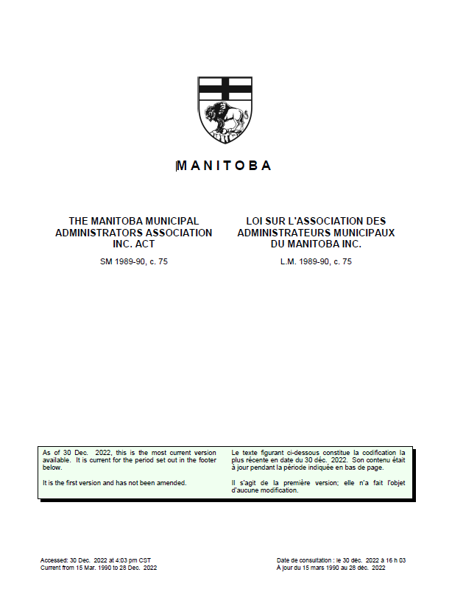
Establishes the organisation
Sets out our purpose
Sets out our ability to regulate our membership (including expulsion)
Sets out our capacity to establish the CMMA course
Provides for a certificate to be awarded to those who complete the course
Limits the use of the CMMA credential
Notes:
The Manitoba Municipal Administrators Association Inc. Act came into effect in 1990 and hasn’t been updated in the 35 years since.
Certificate in Manitoba Municipal Administration

Slide 13
Membership Enhancement
Short-Term (6months) | Mid-Term (6-18months) | Long-Term (18-24months)
Public Membership Registry
Membership By-law
Membership Professional Standards Committee
Membership Approval Policy
MMAA Professional Standards & Code of Conduct
Membership Disciplinary Action Policy
Notes:
Working within the confines of the existing legislation, in 2022 the CMMA Review committee identified that regulation of the membership allowed us to set and uphold standards. By limiting membership to those who met and maintained specific requirements we could promote and enforce professional and ethical standards. We could also hold members who failed to maintain those standards to account.

Slide 14
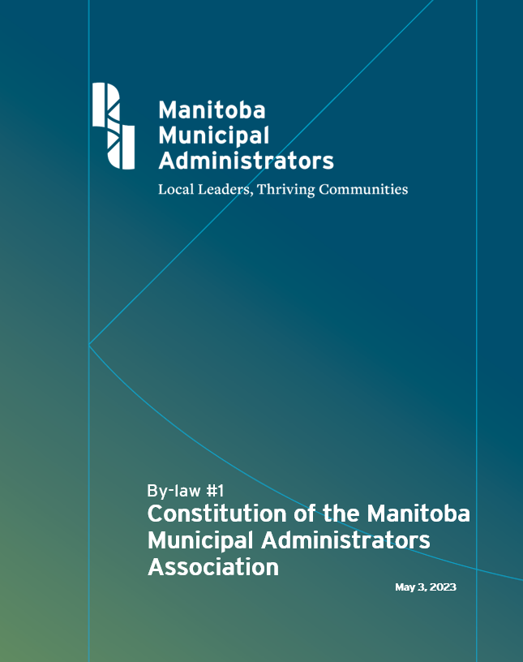
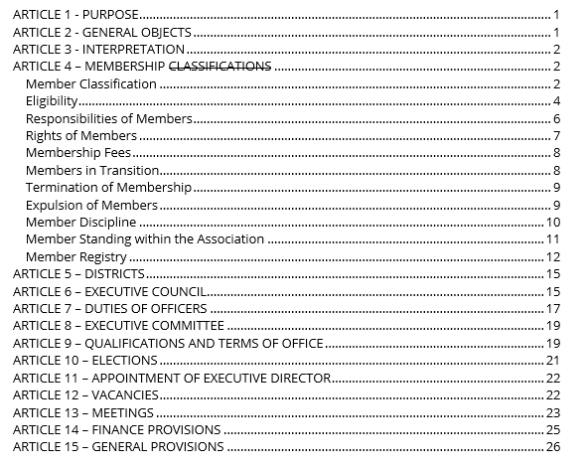
Notes:
At the 2023 AGM, the Membership unanimously approved amendments to our constitution that enacted important changes to how we managed our membership.
First we updated who was eligible to be a member.
Voting members and non-voting members
Next we defined both the rights and the responsibilities of a member
Uphold and act in accordance with this Constitution;
comply with the Association’s By-laws and any policies adopted by the Executive Council;
comply with the Association’s Professional Code of Conduct and any other standards or duties of care as may be established by the Association from time-to-time; and
not interfere or obstruct the purposes, aims and objectives of the Association.
We then we made it possible for a member to be expelled from the association, and we defined a framework for imposing member discipline.
We also created the concept of member status or standing withing the association to allow for a tiered level of discipline should members fail to maintain our standards (Expelled, Suspended, In Good Standing). In order to remain as members in good standing, members must have paid all fees and not be censured/suspended as a result of disciplinary actions
Finally, we articulated that our register of members be made proactively available on our website, and that we include member status as public information so that citizens and elected official could be made aware of any member’s standing with the association.

Slide 15
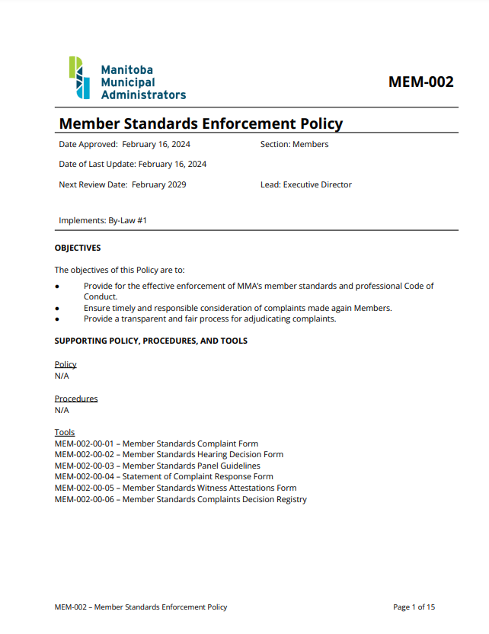
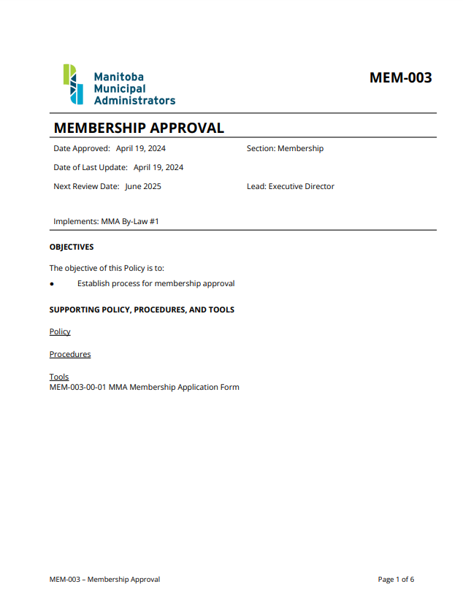
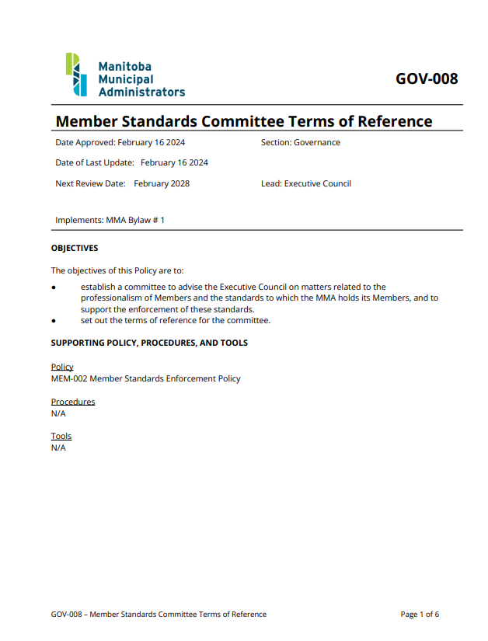
Notes:
Once the by-law was established, the policy framework and tools were created to be able to implement the program envisioned by the CMMA Review committee.
Established the member standards committee. Appointed by the Executive Council. Made up of experienced and well-respected administrators. This committee will conduct all hearings and determine what disciplinary actions should be taken.
Created a membership approval process. It’s important to note that we are seeing more administrators coming into Manitoba from other places or fields. Our new approval process requires that we undertake some investigation into new members to ensure that we are not accepting individuals who have been expelled or have fallen out of good standing with other associations. This is extremely important, as we want to ensure that any new member is a good representative of our membership and that we are assured they will uphold our professional standards.
Created a member standards enforcement policy which sets out the process and rules for handling complaints and conduct issues.

Slide 16
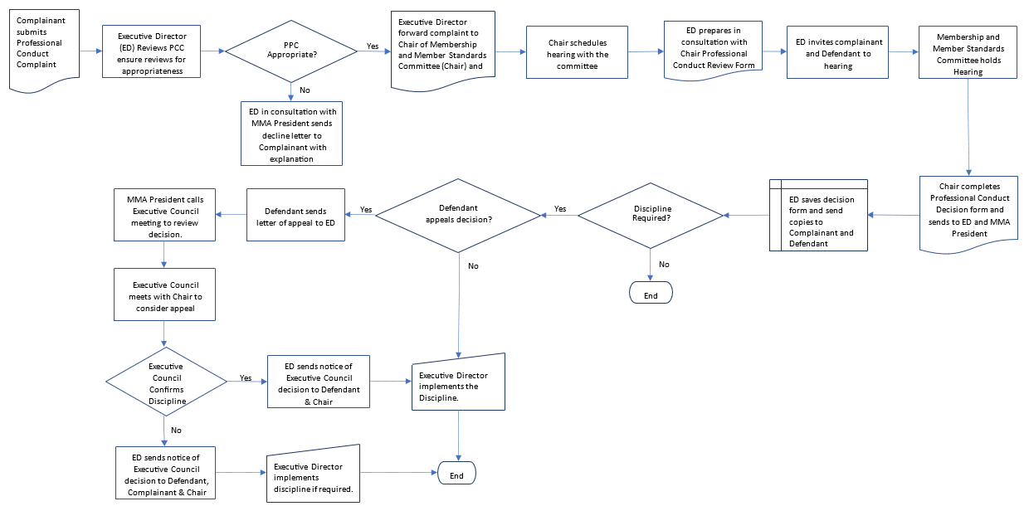
Member Discipline Process
Notes:
Building on the member standards enforcement policy, we wanted to ensure we had an easy to use process that would ensure consistent treatment of complaints. We defined a workflow chart to articulate how the association would handle formal complains against a member. Right now only other members or councils (by resolution) can file formal complaints.
This process is modeled after the Manitoba Law Society’s process for member discipline and it includes a public hearing process, as well as an appeal process for the defendant.
**Walk through chart a bit.
.

Slide 17
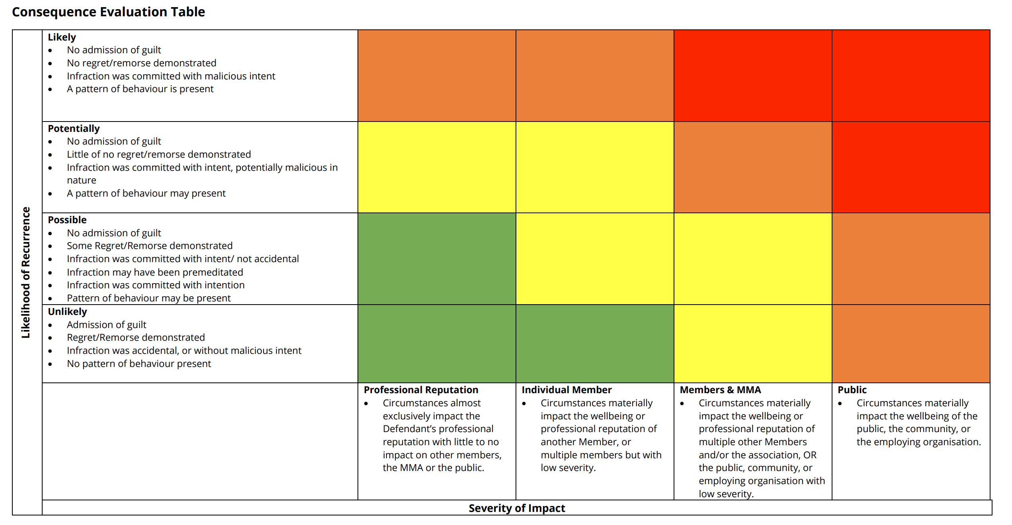
Consequence Evaluation Table
Notes:
We also created the member standards panel guidelines, which provides the committee with a consequence evaluation table and progressive discipline options.
Chart looks at the likelihood of reoccurrence to the severity of impact to help the committee identify the most appropriate discipline options.
Discipline options can include censure/suspension/expulsion, financial penalties and written apologizes/mandatory training.
As an example, if we had a complaint where the member did not admit guilt and had no regret/remorse, it would be determined that they were likely to reoffend. Looking at the severity of the impact, let’s say the person’s actions had a very public impact. They’d be classified as consequence level red, which could include suspension/expulsion, financial penalties not exceeding $5,000, and a written apology / mandatory training.
This chart offers a guide though, and it is ultimately up to the panel to determine the most appropriate course of action given the circumstances.
In 2024 the MMA used the new framework to hold a member accountable for conduct that resulted in criminal conviction. That member was expelled from the association.

Slide 18
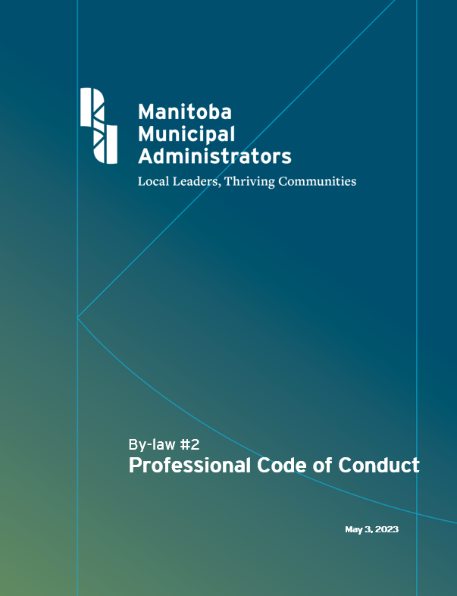
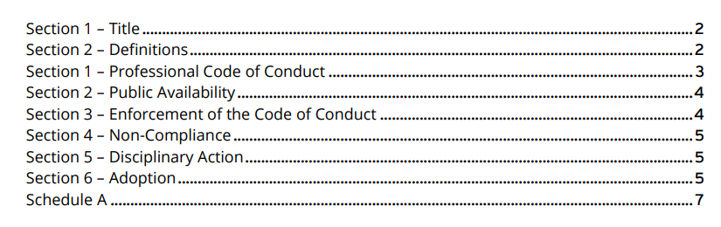
Notes:
In 2023 the membership also unanimously adopted the new Professional Code of Conduct. This code was developed following an extensive review of codes from other associations. Members commit to adhering to the code of conduct upon applying for membership or renewing their membership.
Members must
promote and support effective and democratic municipal government through professional management
affirm the dignity and worth of local government services and maintain a deep sense of social responsibility as a trusted public servant;
fulfill their responsibilities and carry out their duties to the best of their abilities;
demonstrate integrity and the highest standards of ethical behaviour
promote community well-being
ensure the community is informed on municipal matters and promote appropriate community engagement in decision-making;
advise and support elected officials, and fulfill their duties in a politically impartial manner;
carry out their duties fairly and impartially; serving in the interests of all citizen.
maintain separation between their professional and personal interests and shall not leverage their position for personal gain or benefit;
uphold the letter and spirit of the law;
provide high quality advice, analysis, and public policy proposals which are based in fact, use leading practices, and are technically sound;
.behave in a manner that promotes the integrity and reputation of their employer or client;
ensure they fulfill the responsibilities of their position without interference, political or otherwise, resisting any encroachment on their professional responsibilities;
honour and be responsive to the rights and needs of others
be respectful of Members, peers, and colleagues
refrain from undermining, causing malicious injury too, or supplanting of, another member;
promote adherence of all Members to this Professional Code of Conduct
.uphold the letter and spirit of this Professional Code of Conduct;
safeguard and uphold the reputation of the profession and the MMA
bring to the attention of the MMA any apparent breach of this Professional Code of Conduct;
assist the MMA in the enforcement of this Professional Code of Conduct.
Violating the code of conduct is considered a breach of member standards and can result in a formal complaint being filed and adjudicated by our Member Standards Review Committee.

Slide 19

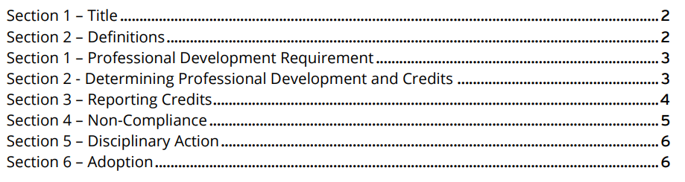
Notes:
In 2023 members unanimously approved amendments to By-law 4, which included increasing the required amount of PD credits a member requires to maintain their membership in good standing by 20%. Members now have to maintain 120 credits over a rolling 3 year period.
Failing to achieve this amount results in the loss of a member’s “in good standing” status. In reviewing other professional associations, on-going professional development was a common requirement and we wanted to ensure that our members had similar requirements. The field we work in seems to change everyday, and making a commitment to lifelong professional development is critical to the success of any administrator.

Slide 20
CMMA Enhancement
Short-Term (6months) | Mid-Term (6-18months) | Long-Term (18-24months)
Competency Framework
Courses
CMMA Curriculum
Practical Requirements
CMMA By-law
CMMA Certification Board
CMMA Certification Policy
Notes:
Currently the CMMA is issued by the University of Manitoba. However, the CMMA review committee set out a road map to pull back the CMMA credential from the University of Manitoba and have it be issued by the MMA. It was identified that this change would allow MMA to include requirements that are not academic in nature, such as practical examination or time-based experience requirements, as part of the criteria to receive the CMMA. The committee also wanted to review the content being delivered to make it comparable to more contemporary and leading programs.

Slide 21
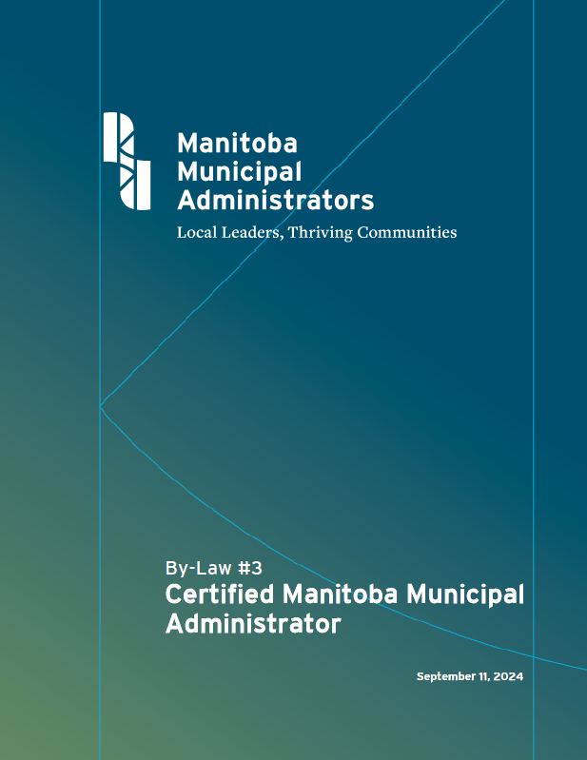
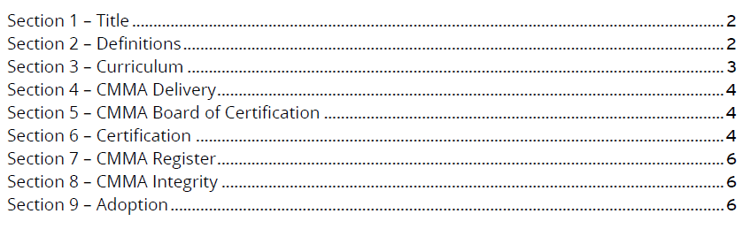
Notes:
In 2024 the membership adopted By-law #3 which, for the first time, set out a clear framework for the CMMA program, established a process for curriculum approval and separated the U of M program from the certification process, transferring that responsibility back to the MMA. Moving forward, the University will issue a certificate, while the CMMA will be issued by the association, once an individual has met the criteria to be set by the Executive and the Board of Certification.
The work to transition the CMMA is ongoing, but this process will fully come into effect on January 1, 2026.
We’ve initiated discussions with the University on this, and on redefining the curriculum and are reviewing the possibility of additional education levels. The University has been and continues to be a great partner with our association and we look forward to continuing our work with them.

Slide 22
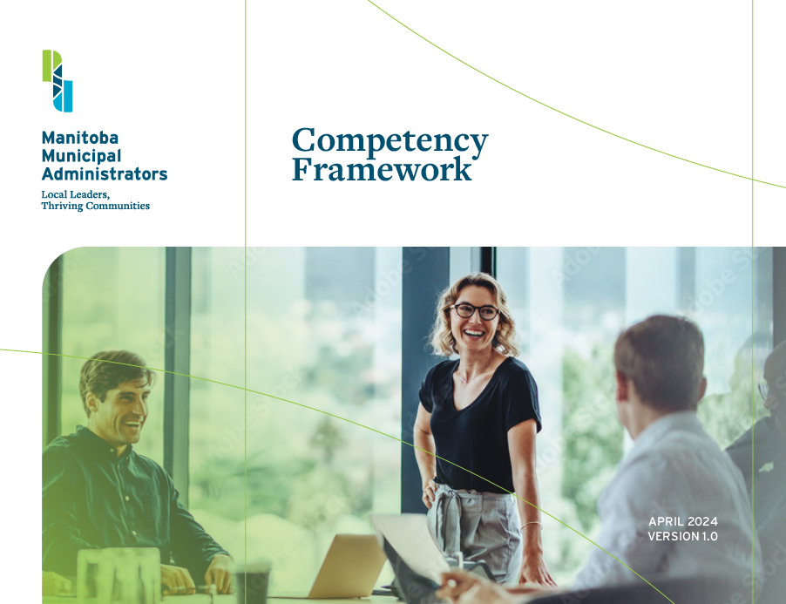
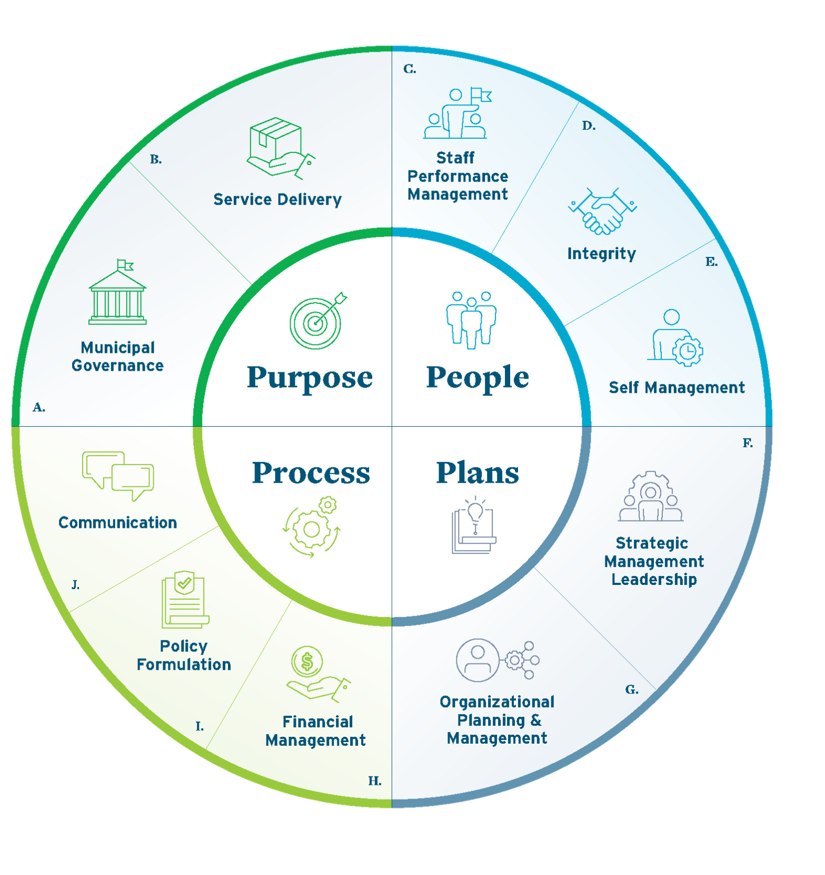
Notes:
In 2024 the MMA established our Competency Framework which sets out the behaviours, knowledge, and skills a professional administrator should have at the three stages of their career; emerging leader, team/program leader, and senior leader.
Central to the framework are our four core drivers, also referred to as the four Ps of municipal administration: Purpose, People, Plans and Process. The four P’s drive our faily work and broadly define the critical aspects and functions of the profession.
From there, the framework identifies 10 core competencies, with 60 sub-competencies which are carefully outlined over 120 pages of material. The framework has been informed by over a dozen other similar frameworks in other jurisdictions as well as insights generated by experienced Manitoba administrators and representatives of AMM.

Slide 23
Municipal Governance
Implementing the Municipal Act and Other Legislation
Operational Knowledge of Municipal Law
Intergovernmental Relations
Political Acumen
Notes:
Taking a closer look at the framework, purpose would be at the core, municipal governance is the competency, and 4 sub-competencies are defined. The framework further defines what achieving these sub-competencies looks like at each stage of leadership.

Slide 24
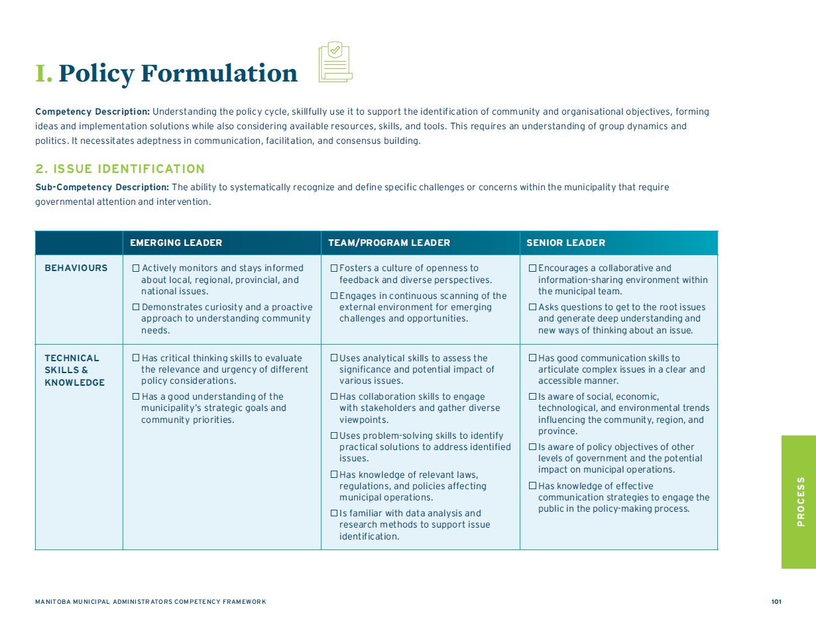
Notes:
The tools is primarily a self-evaluation tool for members to identify strengths and opportunities. It will also serve as a foundational document for our Professional Development program. Using the document, we can plan and deliver training and educational programming that is aligned with and supportive of the competencies defined in the framework.
This year, MMA will launch the Competency Map, which will identify courses and other material that members can take to improve in any of the competencies and sub-competencies. This document will be continuously reviewed and amended to add new material and ensure our members are able to focus on the skills they need most.

Slide 25
Mentorship Program
Started in 2024
Structured program that runs for 6 months at a time
Supports new and aspiring leaders
Notes:
Started in 2024 because we recognized we had a wealth of extremely knowledgeable municipal administrators who wanted to give back.
Heard from members that a lot of employees were interested in CAO/leadership positions but lacked the confidence to take that step.
Also had and continue to have a high number of new caos, a lot from alternate backgrounds with no municipal experience
Wanted to do our part to try and help build connections within the association, as well as support these new leaders or aspiring leaders.
Mentorship committee evaluated other municipal and non-municipal mentorship programs across the country
Developed a very structured program
Interested parties complete an application.
Mentees: where do they need help, current role, communication styles, what are they looking for in a mentor
Mentors: identify area of expertise, current role, communication styles, what are they looking for in a mentee
Committee reviews applications and matches people based on their applications.
Committee offers some training and networking opportunities throughout the program. Partners have to meet 2 hrs a month minimum.
Small commitment; pays dividends.
We’ve seen mentees step into leadership positions and reach new heights in their careers.
Mentors have equally enjoyed the experience, learning as much from their mentees as their mentees learn from them
Been an extremely successful program and we look forward to continued success and mentorship in the future

Slide 26
Next Steps
Notes:
MMA has made a lot of improvements over the past several years to take steps to ensure our members have the tools they need to succeed, but we’re not done yet.
We know that while we have elevated the profile of our members, more needs to be done to ensure we have a steady pipeline of talent and a strong system to hold members accountable.

Slide 27
Next Steps
Requested the province to amend the MMAA Inc. Act
Create the Registered Manitoba Municipal Administrator and Professional Manitoba Municipal Administrator designations
Notes:
In December 2024, representatives from MMA met with Deputy Minister Pandey and her team to request that the Province amend the Manitoba Municipal Administrators Inc. Act, to allow our association to issue and withdraw two professional designations and to make it a requirement for CAOs in Manitoba to have one of the designations.
We have proposed the creation of the Registered Manitoba Municipal Administrator (RMMA) and the Professional Manitoba Municipal Administrator (PMMA). The RMMA is a designation for all administrators and will have lower requirements, while the PMMA designation would have higher requirements, demonstrating advanced preparation for senior leadership roles like the CAO.
What does professionalizing do?
Creates a pipeline for talent, allowing municipal employees from all levels to take training that would prepare them for a senior leadership role in the future.
Provides a path for non-municipal professionals to enter the field
Builds public confidence in municipal leaders by maintaining strong educational requirements and standards to retain membership.

Slide 28
How Can You Help?
Notes:
Require your CAO to be a member of MMA. MMA is a network of strong, professional administrators. We offer high quality professional development and programs to help our members succeed and lead your communities effectively and efficiently. Our Members are required to complete professional development and must adhere to our Code of Conduct. Any members who fail to meet these requirements will lose their member in good standing status, thereby signalling to the council that there may be an issue that needs to be addressed.
Submit complaints if you do feel that there is an issue with one of our members. Our members voted unanimously to approve the changes that allowed us to hold members accountable and to implement the code of conduct. We believe that most of our members are strong, professionals, but if someone loses their way, we want to be here to support you in addressing that issue.
Consider offering membership to other employees to encourage their development and build future leaders. We know that many internal candidates are not currently interested in taking on municipal leadership positions. By investing in these people now, and building their confidence and capabilities, you are increasing the likelihood that you will have prepared and willing successors when the time comes.
Encourage attendance at MMA PD events and participation in programs.
Elton closed their office.
Many councils support their staff to join our board or committees. These are invaluable opportunities to not only give back to the association, but to grow your professional network and skills.
Invest in your ppl and it will pay dividends
Support MMAs lobbying efforts to have the Act changed to allow for there to be a professional designation for Administrative Leaders. We recognize the challenges faced by municipalities. We know that public trust is at an all time low and that there are fewer people interested in taking on these extremely rewarding, but challenging positions. By creating professional designations, we are creating a defined path that not only builds credibility in municipal governance, but signals to people considering their future career, that municipal governance is a great option with a clear path to success.

Slide 29
Thank you

