Slide 1

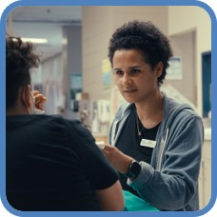


Make It in Manitoba Health Care Retention & Recruitment Office
April 2025

Slide 2
Health Care Retention and Recruitment Office (HCRRO) Presenters
Michele Lane – Provincial Lead, HCRRO Manitoba Health
Dr. Don Klassen – HCRRO Physician Consultant
Dr. Shadi Rezazadeh – HCRRO Physician Consultant

Slide 3
Role of the Health Care Retention & Recruitment Office
Address Barriers
Streamline Recruitment Processes
Implement Innovative Strategies
Operating under Manitoba Health Seniors & Long-Term Care, the Health Care Retention and Recruitment Office (HCRRO) collaborates with Service Delivery Organizations (SDOs), government departments, municipalities, and communities to recruit and retain health care professionals to Manitoba’s health care system.

Slide 4
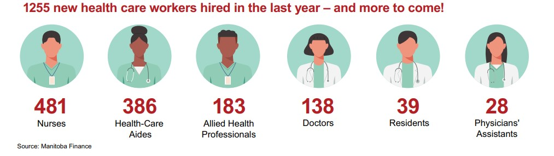

Driven by Government Priorities
The 2024-25 goal to hire 1,000 net new health care professionals was surpassed!

Slide 5
Trends Impacting Healthcare Recruitment
Significant worldwide demand
Changing Interests of Candidates
Intense Competition
Desire for work-life balance and diverse opportunities
Escalating compensation and incentives
Increasing interest in specialization

Slide 6
Trends Impacting Healthcare Recruitment
Continued Challenges with Rural Recruitment
Some communities have insufficient accommodations and/or office space
Upskill and Train Closer to Home
Continue to invest in new training, “exposure opportunities”, and educational programs outside of Winnipeg
Long-term retention concerns due to lifestyle preferences, family supports, and professional resources

Slide 7
Active Recruitment Strategies
Casting a wide net to attract diverse candidate pools is essential to achieving our recruitment targets
Social Media Campaigns
Virtual Information Sessions
Networking Events
Updated Branding & Messaging
Targeted Advertising
Direct Contact
Niche Job Boards
Referrals
Campus Recruiting & Offers at Graduation
Supported by dedicated team of Health System professionals and recruiters

Slide 8

Candidates Actively Being Recruited
Learners – “grow your own”
All Manitoba colleges and all levels of study
Manitobans studying outside of the province
External Experienced Professionals
Agency, private clinics, retirees
Internationally Educated Professionals in Manitoba
Professionals needing support to complete requirements to become fully licensed
U.S., UK, Ireland, Australia
Experienced International Professionals
Retain and return home our local talent. Extend offers before graduation
Recruit experienced professionals back to Manitoba’s health care system
Support those already living in Manitoba to upskill and fill critical health system roles
Recruit from countries with similar education and licensing

Slide 9

Refreshed Recruitment Strategies
Making progress
Year-round, Dedicated Campus Recruiting
U.S Recruitment
Targeted Networking
Numerous campus recruitment events attracting over 600 students studying health care professions
Continued focus on matching students to health system vacancies prior to graduation
Given current shifts in U.S. policies and values, target candidates from neighbouring U.S. states
3 nurses recruited so far
In active conversation with several physicians
Significant increase in interest in information session events
Physician recruiters continue to attend focused events in Canada and the U.K. to attract experienced physicians

Slide 10
Making progress
Simplified pathways for Internationally Medical Graduates (IMGs)
Practice Ready Assessment Program (PRA)
For IMGs who have completed residency training and can practice independently
Prior to licensing, IMG candidates have skills assessed to ensure skills meet CPSM standards
Enrollment requires an approved sponsor and job offer in a clinical area deemed to be of high need in Manitoba
Work with CPSM and UofM to streamline licensing
Collaborate with UofM to introduce PRAs for Family Medicine IMGs
For IMGs requiring further training prior to licensing, Clinical Assistant positions offer opportunities to gain experience and supports physicians with patient panels.

Slide 11





Making progress
Licensing Internationally Educated Nurses:
Manitoba IEN Program
Focused effort promoting and enrolling IENs to the Manitoba IEN program which supports licensure navigation and financial assistance
Any person who worked as a nurse outside of Canada is encouraged to apply
First Point of Contact
Personalized
Support
Pathway
Navigation
Access to
Services
Job Search
Assistance
Complete
Licensure

Slide 12
Making progress
Education closer to Home to “Grow our Own”
More “roaming” sites for LPNs training in strategic rural locations
More resident and medical lab technologist seats in rural Manitoba
New training seats at University College of the North for health care aids and paramedic training
Continue rural experience programs for medical students and residents via Rural Week, Home for the Summer, and rural rotations
Support locum programs for rural and northern physicians to attend continuing medical education and take vacation
2/3 of Family Medicine resident training is outside of Winnipeg

Slide 13
Partnering is Key to Success
Collaborate with post-secondary schools and professional associations to decrease barriers
Work with SDO leadership to address regional trends, needs and priorities
Partner with municipalities to create supports for health professionals working in the community
Align with provincial government departments to create new opportunities

Slide 14
Working Together
Practice Opportunities
Social Networks & Community Integration
Supports for Spouses and Families
Retention of Healthcare Professionals
Notes:
Practice Opportunities
Facilities and equipment
Work-Life Balance
Practice support/multi-disciplinary teams
Mentorship/Collegiality
Community Integration
Housing
Amenities
Community socialization
Entertainment options
Support for Families
Family supports
Work for spouse
Childcare/kids activities
Quality Education

Slide 15
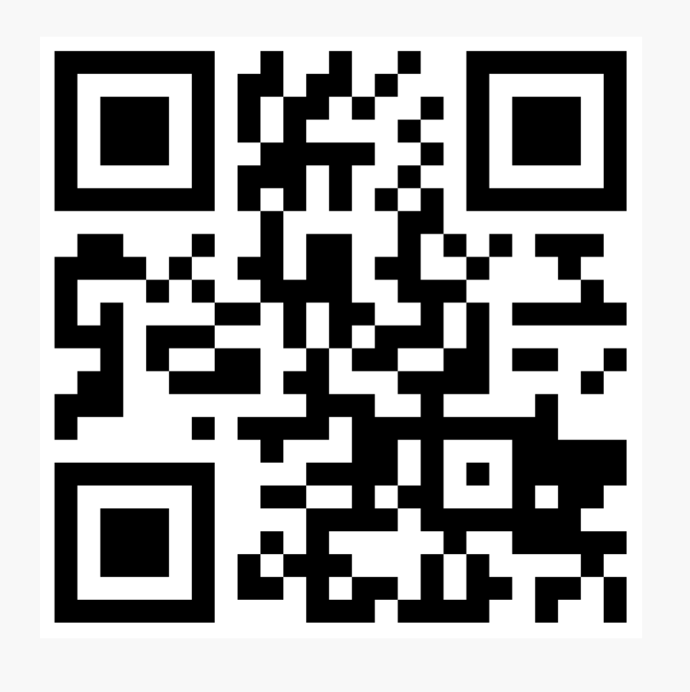
Next Steps
Partner with the HCRRO on a Recruitment and Retention Toolkit
A critical success factor for healthcare recruitment is to ensure every step in the recruitment process is aligned.
To support municipalities in welcoming and retaining new healthcare providers into their communities, the HCRRO is developing a recruitment and retention toolkit that will include information, checklists, and leading practices used in other communities across Canada.
We need your input! If you are interested in volunteering to work with us on developing a Made-in-Manitoba Recruitment and Retention Toolkit, please email:
hcrro1@gov.mb.ca

Slide 16


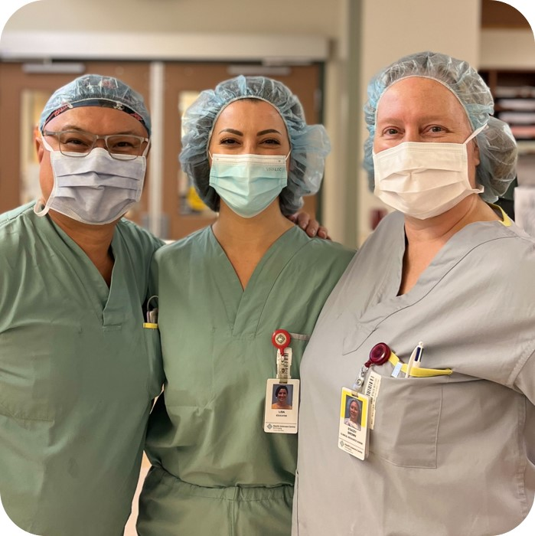



Questions?
makeitinmanitoba.ca

